Slide 1

Clean Code An alternative way of coding
Sharon Mei Jan. 2013

Slide 2


Slide 3
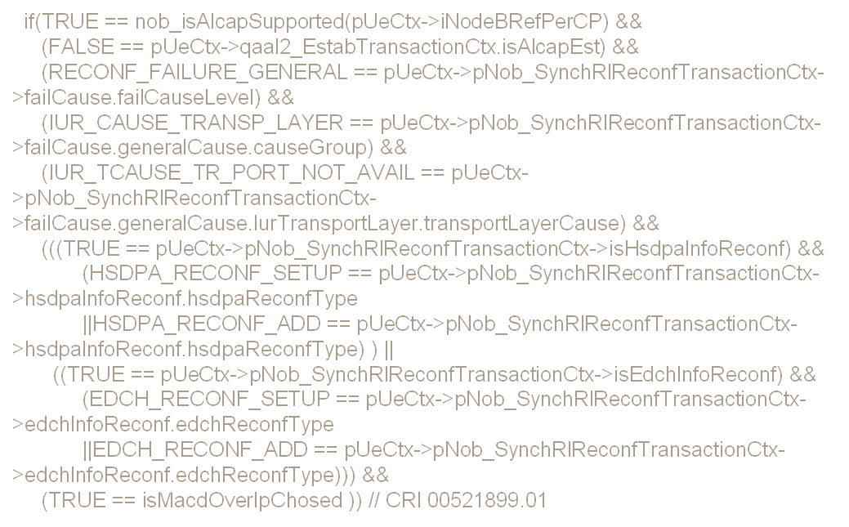

Why clean code

Slide 4
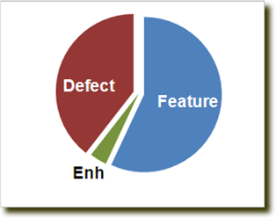

Slide 5
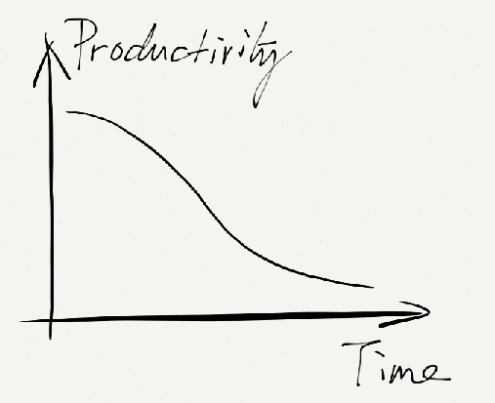

Slide 6
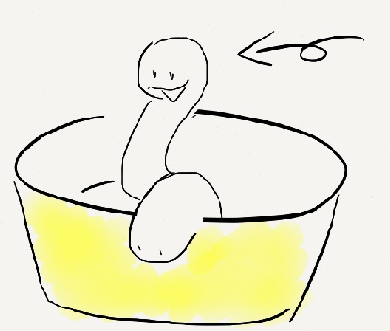
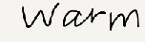
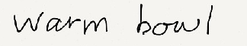
Not bug yet

Slide 7

What is clean code

Slide 8
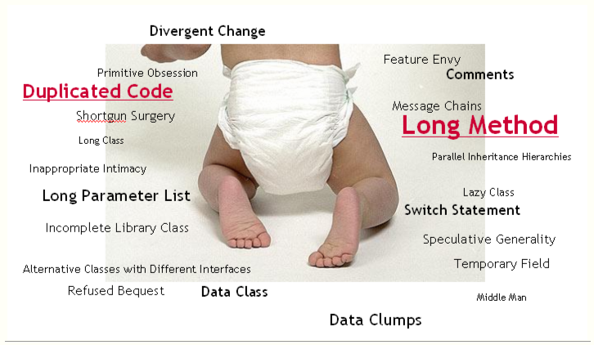
Code Smells

Slide 9

Elegant
As Expected
Care for Code
Efficient
No Duplication
Explicit
Minimal Dependency
Simple
Direct
Optimal
Having unit & acceptance test

Slide 10


Slide 11


Slide 12
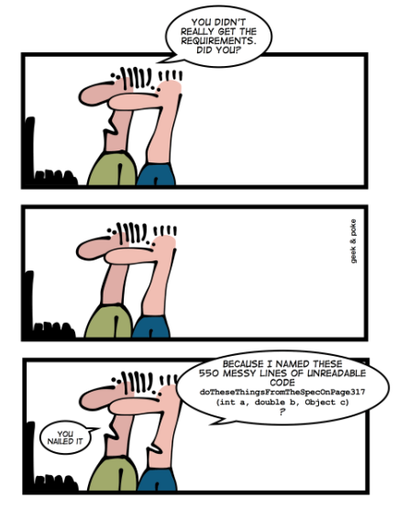

Slide 13
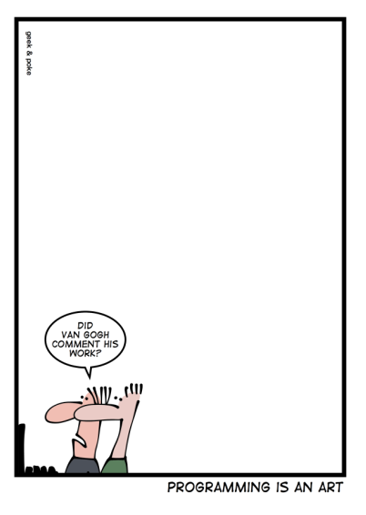

Slide 14
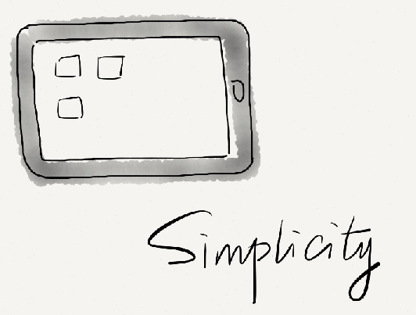
There are two ways of constructing a software design: One way is to make it so simple that there are obviously no deficiencies, and the other way is to take it so complicated that there are no obvious deficiencies. The first method is far more difficult.
-- C.A.R. Hoare

Slide 15
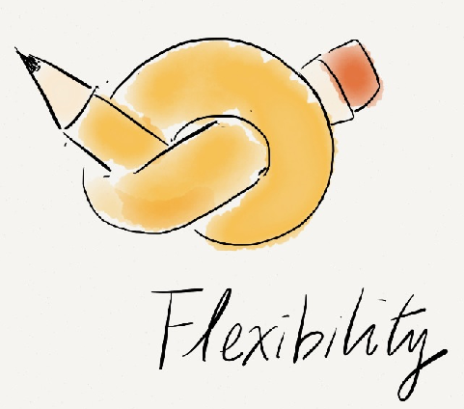

Slide 16
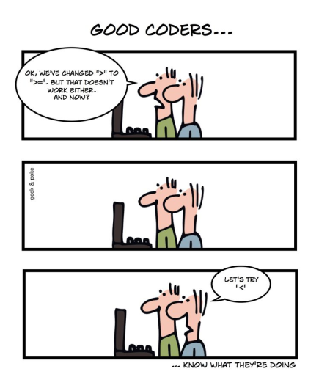

Slide 17
How to write clean code

Slide 18
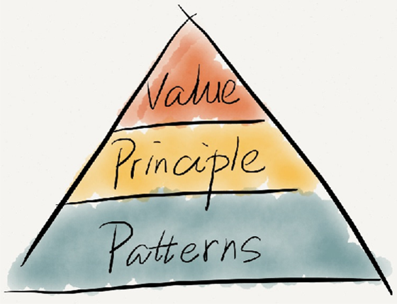
In theory there is no difference between theory and practice, in practice there is

Slide 19
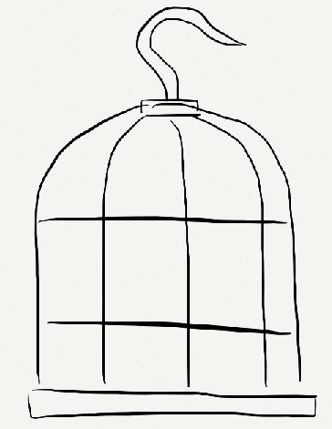
Principle: Local Consequence
High cohesion & Low coupling
Divide & concur

Slide 20
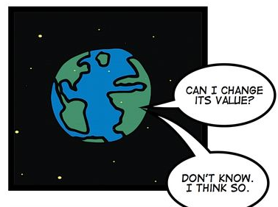

Slide 21
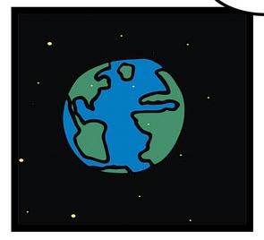

Slide 22


Slide 23
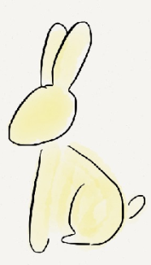


Minimize Repetition

Slide 24
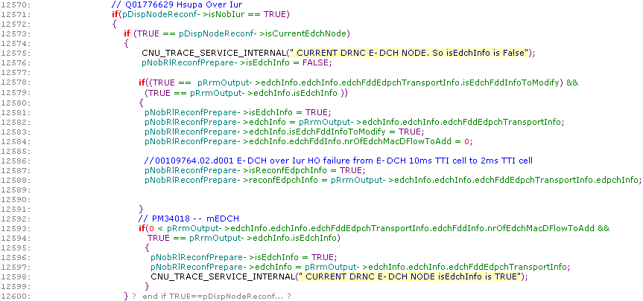
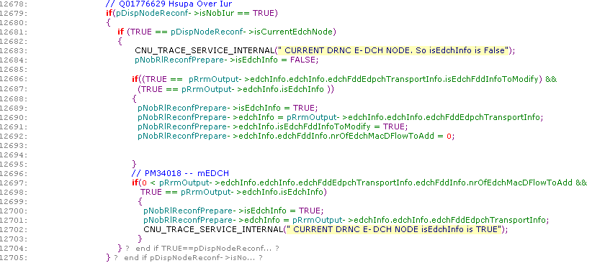
Difference within duplications

Slide 25
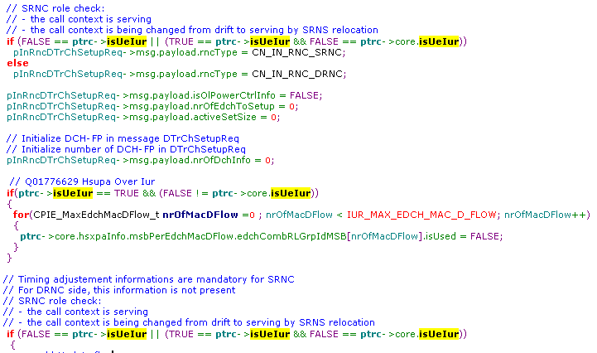
Duplicate Conditions

Slide 26
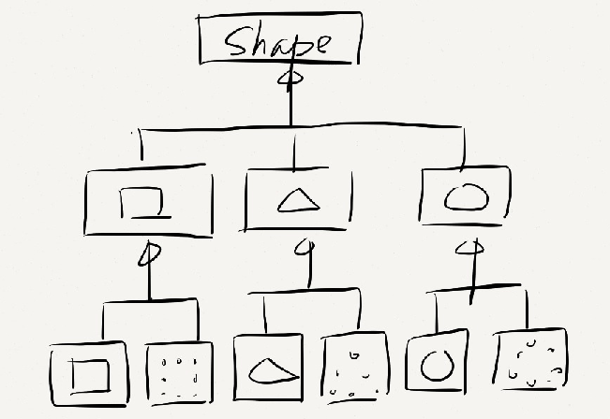
Duplication in class hierarchy

Slide 27
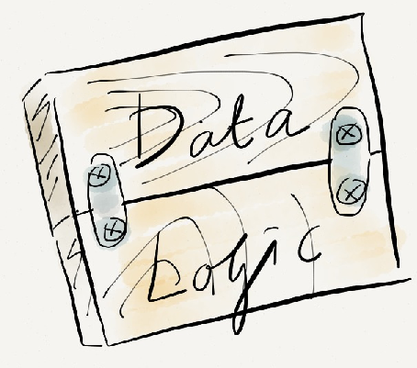
Logic and Data Together

Slide 28
void chargeCustomer(Customer *customer, Currency amout){
Wallet *customerWallet = customer->getWallet();
if (customerWallet->cashAmount() > amount)
customerWallet->fetchCash(amount);
else
chargeCustomerByCreditCard(customer, amount);
}
Casher → Customer → Wallet → CashAmount

Slide 29
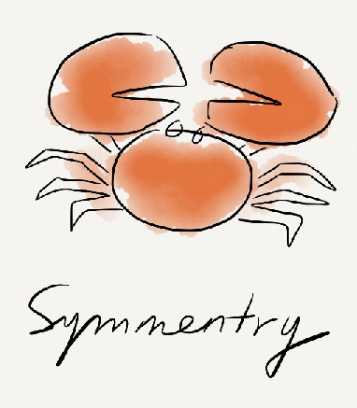
Principle: Symmetry

Slide 30




void process(){
input();
count ++;
output();
}
void process(){
input();
incrementCount();
output();
}
void process(){
input();
tally();
output();
}

Slide 31
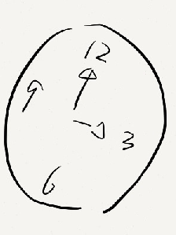
Same Rate of Changing

Slide 32
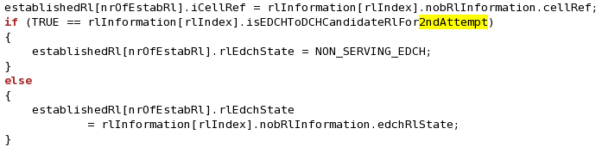
Condition on Procedure
Different change rate

Slide 33
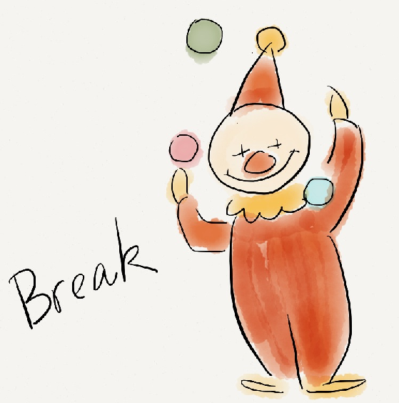

Slide 34
What is Pattern

Slide 35
Draw a Bridge
1
2
3
4

Slide 36
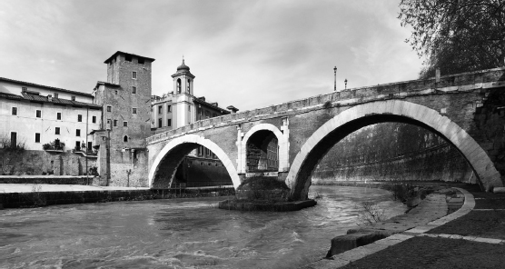
The Ponte Fabricio in Rome built in 62 BC

Slide 37
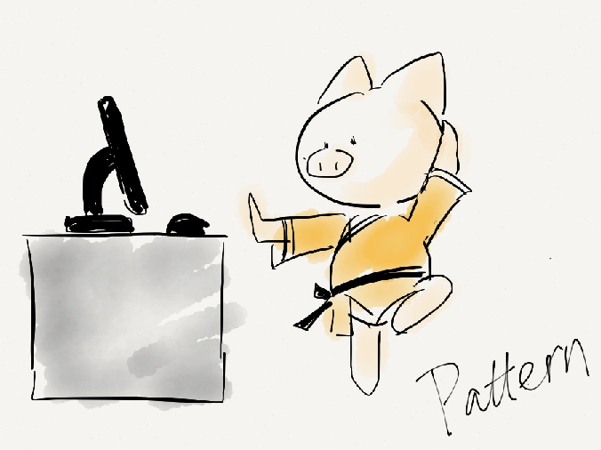
Patterns
Name: communication
Problem: relative priorities of the forces
Solution: avoid effort waste on “known” problems

Slide 38
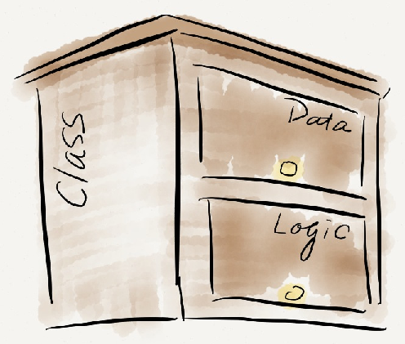
Class
“is a”
Data & Logic Together

Slide 39
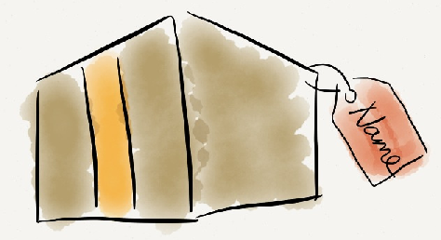
Simple Superclass Name
Qualified Subclass Name

Slide 40
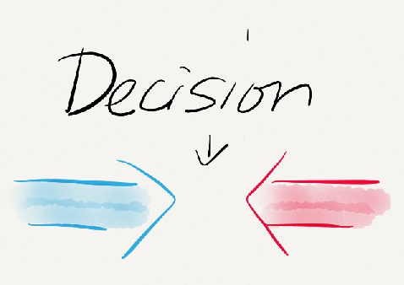
Code to Interface
Flexibility vs. Cost
Inherit vs. Delegation
Reuse vs. Dependency

Slide 41
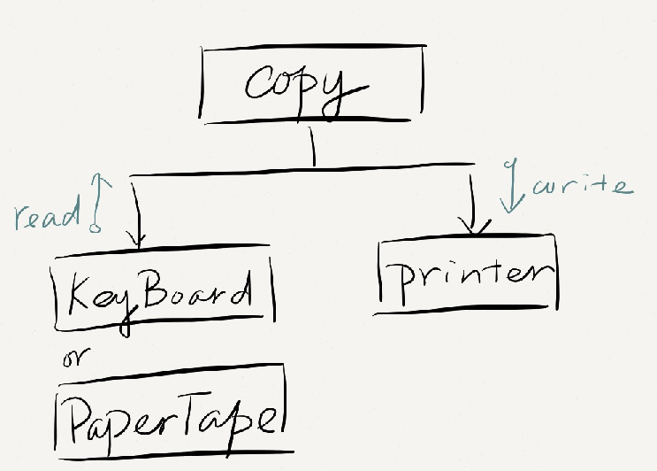
Copy Program -- Copy characters from reader to writer

Slide 42
Depend on Implementation
//remember to reset these flags
public static bool ptFlag = false;
public static void Copy() {
char c;
while((c=(ptFlag ? PaperTape.Read() :
Keyboard.Read())) != -1)
PaperTape.write(c);
}

Slide 43
Code to Interface
private Reader * reader;
public void Copy() {
char c;
while((c=reader->read()) != -1)
PaperTape.write(c);
}
reader->read()

Slide 44
int add(){
return 1 + 1;
}
int add(int x, int y){
return x + y;
}
Different Value
x, y can represent any concrete number
void copy(){
…
keyBoard->read();
…
}
void copy(Reader * reader){
…
reader->read();
…
}
Different Behavior
reader can represent any concrete reader, e.g. keyBoard, paperTape

Slide 45
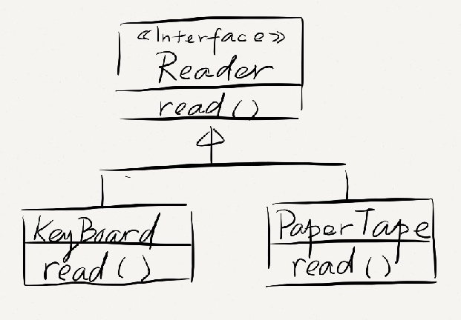
Intention with no details implementations
Implement reading from PaperTape
Implement reading from KeyBoard
Polymorphism different behavior
Notes:
很多面向对象语言像C++一样，要求可以替换的行为有共同的基类
基类代表抽象的可替换，可变的行为，但是没有具体实现
子类代表不同的具体行为
Python, Ruby这种动态语言中都不需要
Java中有显示的接口定义
好了，这就是面向接口编程的全部了，非常有用的一个招式
值得强调的是，这样的灵活性是有代价的，如果我们的copy程序终生只用到一个输入设备，我们不必要做这么多的考虑

Slide 46
private Reader * reader;
public void Copy() {
char c;
while((c=reader->read()) != -1)
PaperTape.write(c);
}
What if reader
is NULL?
Notes:
好，趁热打铁，我们在介绍一个利用多态的小窍门
会让我们的代码变得更干净的窍门
我们回到已经变成面向接口风格的拷贝程序，他还有一个问题
如果用户传入了一个空指针呢？
为了我们的程序的健壮性，我们需要在函数的入口检查传入的指针，判断reader是不是一个空指针
这个太讨厌了
我真想给大家看看我曾经工作过的代码，看任何一个函数，一开头，长长的一大段逻辑都在判断指针是不是空，
简直就不知道这个函数真正的逻辑从哪里开始

Slide 47
Don't pass NULL !!
Notes:
我们今天讲干净代码给大家的一个提示是，不要传递空指针
空指针和其它程序的其它输入不一样，它绝对不是系统外部传入的，因此他是程序本身可控的
我们要学习的就是怎么控制它

Slide 48
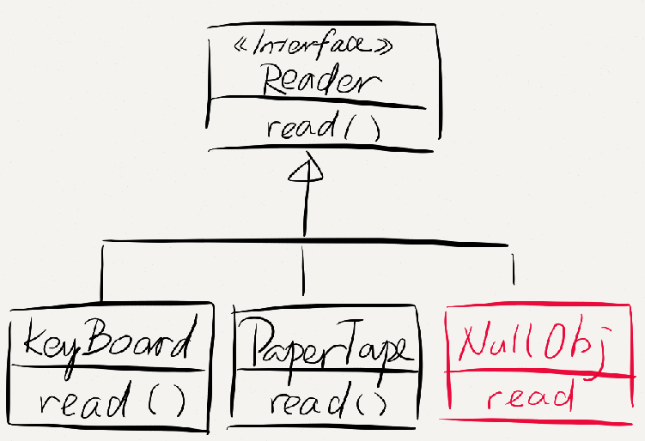
Pass a NULL Object instead
class NULLObj : public Reader{
public char read() {
return -1;
}
}
Put what you want the program do when reader is NULL here

Slide 49
Duplicate Conditions

Slide 50
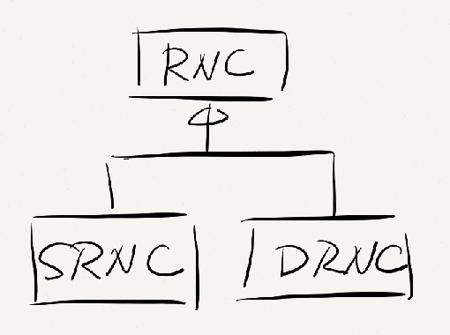

Slide 51
Duplication in class hierarchy

Slide 52
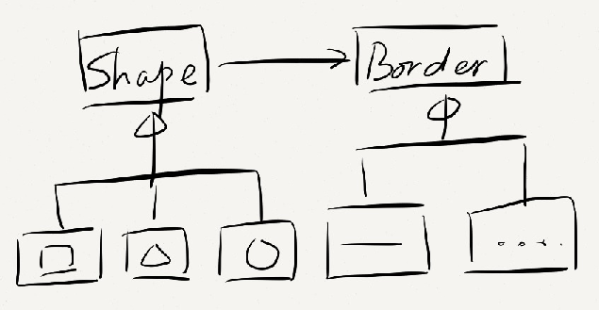
Delegation over inherit

Slide 53
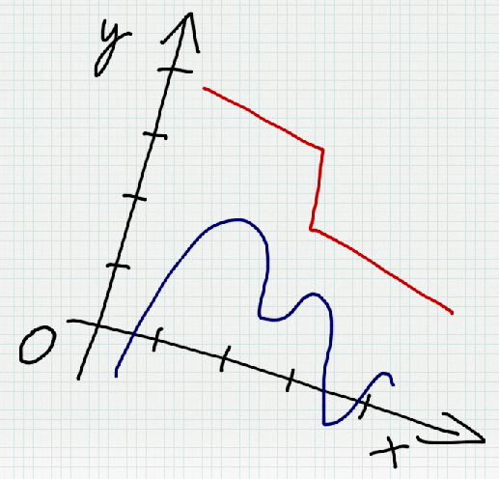
Data

Slide 54
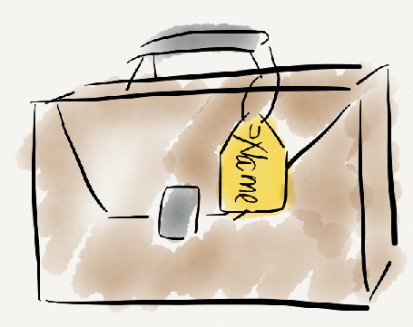
Scope
Lifetime
Type
Intention

Slide 55
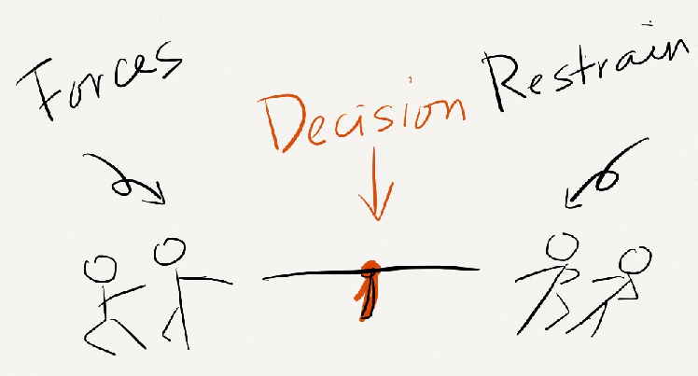
Initialization
Eager vs. lazy
Access Direct vs. Expressive
Variance Value vs. Entity

Slide 56
Eager Initialize
Lazy Initialize
class Point {
int x, y;
Point(int x, int y) {
this.x= x;
this.y= y;
}
}
List getMembers() {
if (members == null)
members = new ArrayList<Person>();
return members;
}

Slide 57
Indirect Access
Direct Access
openDoor();
doorRegister = 1;
?? getx()
?? setx()
setBg(Yellow)
highLight()

Slide 58
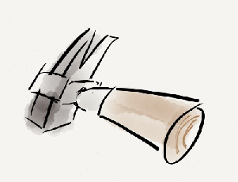

Variant
Value
Entity
Variable Field

Slide 59
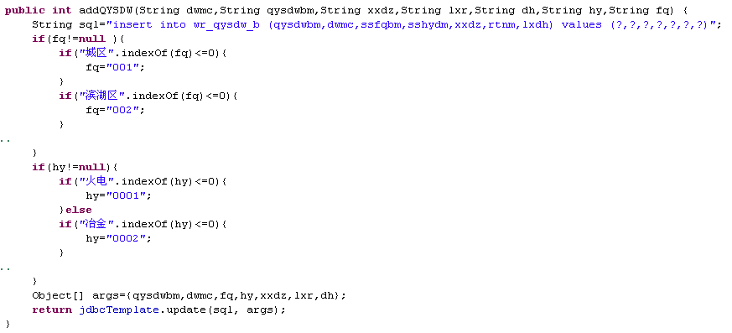

Slide 60
Logic
0x2B | !0x2B

Slide 61
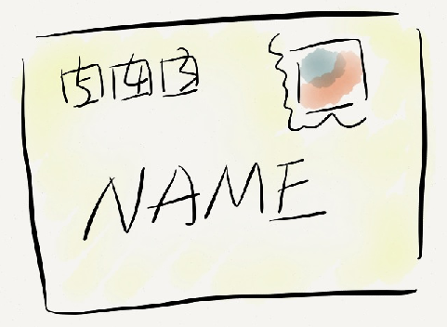
Implementation
Intention

Slide 62

Method Size
Return type
Main flow
Exception
Dispatching

Slide 63
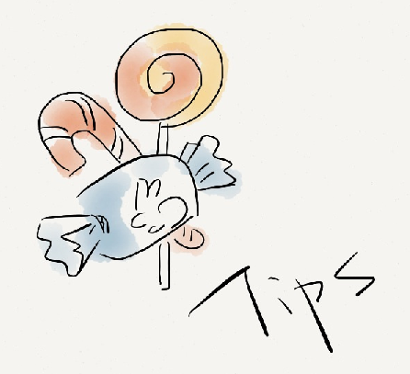
Logic (3/3): Tips
Guard Clause
Method object

Slide 64
What nobCallRlSetupInvoke Do
To allocate cell resources for each RL to setup
for (eachRl){
If (TRUE == conditionA){
rc = allocateResouceA(paraA1, paraA2 …);
}
…
}
Problem Domain
Notes:
This introduction is based on the refactoring of a function named “nobcallRlSetupInvoke”, which is actually a function in CELLRRM (not NOBCALL)
Before we start with the 2 technices, let’s see what this function do.
nobcallRlSetupInvoke is to allocate cell resources for all the RLs to setup.
There are kinds of cell resources, e.g. spreading code, power, hrnti, etc.
And when there is not enough of resource for the rl, the setup request will be rejected, and other resources had allocated need to be released
In the blue block, it’s the pseudo code for a typical resource allocation in this function
The “for” loop means we will have to allocate cell resources for all the RLs
And normally, we allocate one type of resource based on some condition, say, we only allocate HRNTI for hsdpa RL, that is why we have a if condition in the 2nd line
The 3rd line is the real code to allocate the resource, allocateResourceA is the function name, it has several input arguments, paraA1, paraA2, etc., and it has a return code, if the allocation success, it will return RC_OK, and if it’s failed to allocate, say, because of not enough resource, it will return RC_ERROR

Slide 65
If (TRUE == conditionA){
rc = allocateResouceA(paraA1, paraA2);
if(RC_OK == rc){
if(TRUE == conditionB){
rc = allocateResourceB(paraB1, paraB2…);
if(RC_OK == rc){
if(TRUE == conditionC){
rc = allocateResourceC(paraC1, paraC2…);
if(RC_OK == rc) …
else{
if(TRUE == conditionA){
releaseResourceA(paraA1, paraA2…)
}
if(TRUE == cocnditionB){
releaseResourceB(paraB1, paraB2…)
}
}
}
else{
if(TRUE == conditionA{
releaseResourceA(paraA1, paraA2…);
}
}
}
More than one resource to allocate
Hard to read
Nested main flow
Error handling is far from error
Code Skeleton
Notes:
Code becomes messier when there ae more than one type of resources to allocate for a RL
On the left side of this slides, it’s the code skeleton to allocate 3 types of resources
That is, we first allocate resource A
If allocation success, we go with resource B allocation
What if the it’s failed, when it’s failed allocate resource A, it’s hard to figure out the error handling code, actually as the 1st resource allocated, there is nothing to do for the error handling ☺
Let’s move one to see resource B allocation
If it’s OK, move on to allocate resource C
If it’s failed to allocate resource B, still, a little bit hard to figure out the error handling code, it’s the last 2 lines of code in red, when it’s failed to allocate resource B, we will have to release the resource A previously allocated
Same thing goes with resource C allocation
If it’s OK, move on to allocate other types of resources, dot dot dot
And if it’s failed, release resource A and B previously allocated
Well that’s the code.
It’s hard to read for 2 reasons
1st, it has nested if/else clause, nested main flow
2nd, the error handling code is far away from the error point
We will use guard clause to solve these 2 problem
Note:
Code Skeleton is the form of code with details hidden and only branches left

Slide 66
If (TRUE == conditionA){
rc = allocateResouceA(paraA1, paraA2);
}
if(RC_ERROR == rc){
continue;
}
If (TRUE == conditionB){
rc = allocateResouceB(paraB1, paraB2);
}
if(RC_ERROR == rc){
if(TRUE == conditionA){
releaseResourceA(paraA1, paraA2…);
}
continue;
}
If(TRUE == conditionC){
rc = allocateResourceC(paraC1, paraC2…);
}
If(RC_ERROR == rc)
{
if(TRUE == conditionA){
releaseResourceA(para…);
}
if(TRUE == conditionB){
releaseREsourceB(para…);
}
continue;
}
Guard clause says, "This is rare, and if it happens, do something and get out”
Same logic with previous code
Easier to read
Straight main flow
Error handling is close to where error occurs
Guard Clause
Notes:
Guard Clause says that if there is something unusual happens, handle it, and quite as soon as possible.
Let’s look into the code again
Allocate resource A
If it’s failed, as we don’t do anything to handle it, we just stop, continues statement there is a explicit statement to say “get out”
Allocate resource B
If it’s failed, release resource A, and “get out” – the continues statement
Same thing goes with resource C, allocate resource C
If it’s failed, release resource A and B, and “get out”
This piece of code has the same logic with the code in last page, however, it’s easier to read
it’s main flow goes straight
Error handling code is close to the error point
Guard Clause is often used to solve nested if/else clause
Especially if clause and else clause are not even, one is normal case and other is rare to happen
Well, it does not always work, when the if and else clause are equally important, and both likely to happen, then guard clause is not suggested.

Slide 67
How to write clean code More than just coding

Slide 68
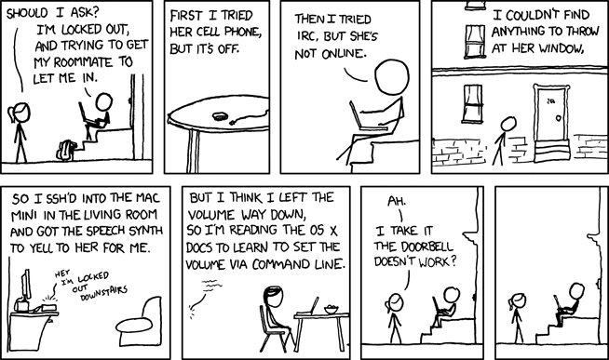
Notes:
Talk about work around again

Slide 69
Passes its tests
Minimizes duplication
Maximizes clarity
Has fewer elements

Slide 70
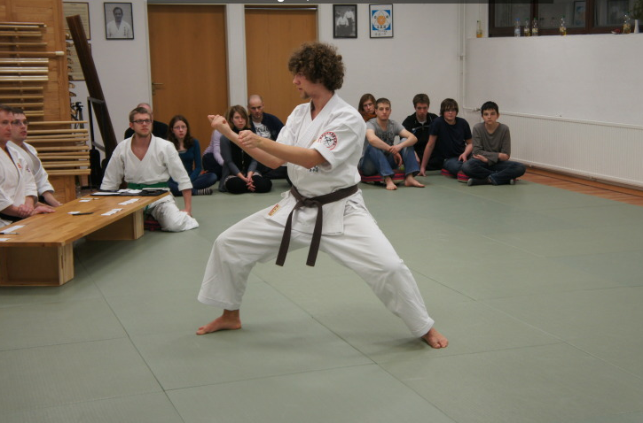
Dojo

Slide 71
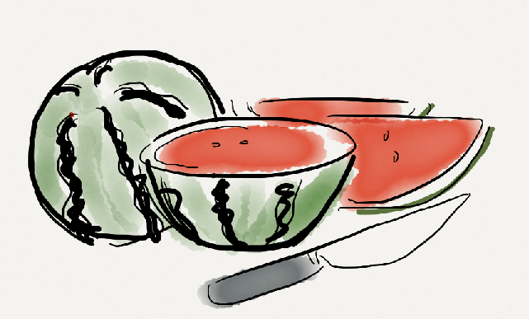
Divide & Conquer vs. Conquer & Divide
Notes:
Refactoring because better alternative exist

Slide 72
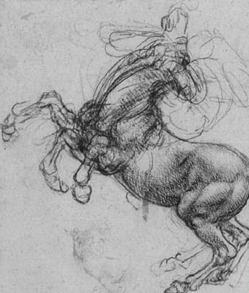
Feedback Correction

Slide 73
Economy Thinking on Clean Code
Clean Code worth more as it has poor alternative dropped
Opportunity Cost
Clean Code worth more when demands increases
It’s essential that management recognize clean code
External cost & profit

Slide 74
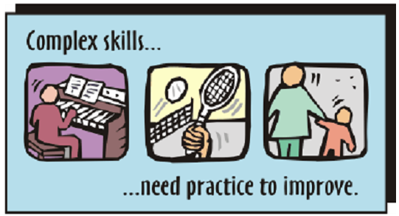
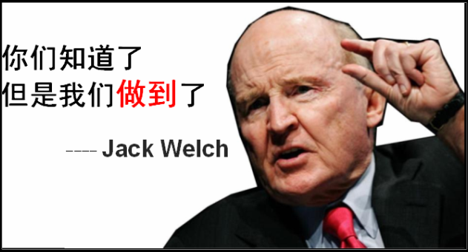
心致行致

Slide 75
In theory there is no difference between theory and practice, in practice there is

Slide 76
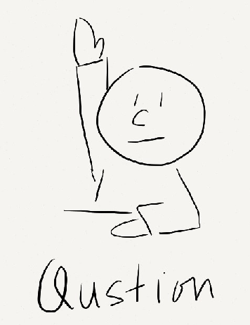
Questions

Slide 77


Slide 78

Done
@SharonMei1219

Slide 79

Practice

Slide 80



Poker Hand

Slide 81

References:
>

Slide 82
Notes:
Talk about work around again

Slide 83


Slide 84


Slide 85


Slide 86


